Slide 1
srcSlice: Very efficient and scalable forward static slicing Hakam W. Alomari, Michael L. Collard, Jonathan I.Maletic, Nouh Alhindawi, Omar Meqdadi Journal of Software : Evolution and Process, Volume 26, Issue 11, November 2014.
Presented by
Siddarth Udayakumar

Slide 2
Abstract
Highly efficient lightweight forward static slicing approach.
No Program/System dependence graph.
Computation as and when needed.
Implemented as tool called srcSlice.
Highly scalable approach.
Benchmarked with codesurfer.

Slide 3
Program Slicing
Computing program statements.
Set of statements – program slice.
Values affected at some point – slicing criterion.
Debugging, used for model checking, test coverage.
Originally defined by Mark Weiser.
Different types of slicing.

Slide 4
Introduction
Program Slicing – Understand and detect impact of changes
Variable and location of that variable
Slice – parts of program affected by variable. Maintenance tasks.
Slice S(A, 10) – Affecting A in 10.
Weiser– executable program that preserved behavior of original.
Based on Program Dependence graph.
Notes:
How presentation will benefit audience: Adult learners are more interested in a subject if they know how or why it is important to them.
Presenter’s level of expertise in the subject: Briefly state your credentials in this area, or explain why participants should listen to you.

Slide 5
Introduction (Contd)
Eliminate time and Effort to build PDG
Combination of text approach and lightweight static analysis.
Slicing – srcML (Source code Markup Language).
Fast and Scalable but less accurate.
Efficient with respect to Computational time
Implemented approach using srcSlice tool.
Notes:
Lesson descriptions should be brief.

Slide 6
Forward Slicing
Program | Forward Slice
n = 0; product = 1; sum = 1; scanf("%d",&x) ; while (x >= 0){ sum = sum + x; product = product * x ; n = n + 1; scanf("%d",&x); } average = (sum - 1) / n ; printf("The total is %d\n",sum) ; printf("The product is %d\n",product) ; printf("The average is %d\n",average) ; | n = 0; product = 1; sum = 0; scanf("%d",&x) ; while (x >= 0) { sum = sum + x; /* AFFECTED */ product = product * x ; n = n + 1; scanf("%d",&x); } Average = (sum - 1) / n ; /* AFFECTED */ printf("The total is %d\n",sum) ; /* AFFECTED */ printf("The product is %d\n",product) ; printf("The average is %d\n",average) ; /* AFFECTED */
Forward slice from point P includes all points in forward control flow affected by computation at P.
Notes:
Example objectives
At the end of this lesson, you will be able to:
Save files to the team Web server.
Move files to different locations on the team Web server.
Share files on the team Web server.

Slide 7
Lightweight Forward Static Slicing
Forward, Static, non executable and inter-procedural program slice for each variable.
PDG is not computed for entire program, no precise reference location for slicing criterion.
Forward Slice – Not executable but Binkley et al – Complement executable forward slice.
Complement forward slice – execution not affected by slicing criterion.
Approach – follows original convention but extension is used for executable slices.

Slide 8
Lightweight Forward Static Slicing (Contd..)
Approach relies on XML representation of Source – srcML.
Augments source code with abstract syntactic information.
Syntactic info – id program dependencies.
srcML format – toolkits like src2srcml, scrcml2src.
Lightweight fact extraction, source code transform, pattern matching.

Slide 9
Extended Decomposition Slicing Criterion
Slicing criterion – file name, function name, variable name.
S(f, m, v). Decomposition slice - Gallagher et al.
Union of collection of slices of individual statements of a variable.
Adapt it to forward static slicing.
Slice at statements that define a variable.
Slice obtained from slicing algorithm – D Slice computed.

Slide 10
Slice Profile and System Dictionary Construction
Algorithm does not rely on pre computed data and control dependencies.
Required dependencies for slicing calculated as and when needed.
Slice Profile – statements from all slices for slicing variable V.
System dictionary – (f, m, v).

Slide 11
Slice Profile Structure for Dictionary
• file, function, and variable names;
• @index, an index of each variable in the order that it was declared in the function;
• slines, a list of lines that comprise the slice;
• cfunctions, a list of functions called using the slicing variable;
• dvariables, a list of variables that are data dependent on the slice variable;
• pointers, a list of aliases of the slicing variable; and
• controledges, a list of all possible control-flow edges of the slicing variable.

Slide 12
Criterion Definition
Forward Decomposition Slice
General Forward Decomposition Slice
Decomposition Slice - special case for simultaneous slicing
- variation of original definition by Weiser

Slide 13
Algorithm Overview
Slice Profiles for all variables are computed.
After above step, system dictionary is used to take into account variables, function calls, to generate final slices.
Algorithm – computation of forward decomposition slice.
Given Below are the main algorithms used in this paper:
ComputeSliceProfile – Used for intra-procedural slicing
ComputeInterProcedural – Inter-procedural slicing.
ComputeControlPaths – generate control flow paths for slices.

Slide 14
Computing Control Flow Paths
Facilitates handling of unstructured control flow.
Our approach – no control flow information stored during slice production.
Storage causes computational overhead so used when required.
Generate CF paths -extending ComputeSliceProfile – sequence info between lines.
Two control flow edges for each block
(predecessor, true successor)
(predecessor, false successor)

Slide 15
Control Flow Paths

Slide 16
Pointer Analysis
Keep track of aliases in the slice profile.
Slice of aliased variables VP is added to slice of variable V for final computation.
Direct pointer aliases and call by references are supported.

Slide 17
Implementation.
Implemented approach as srcSlice tool. C++ code. SrcML as input.
src2srcML is applied on program to convert to srcML.
Source code – unprocessed. Conversion is fast (28KLOC/s).
srcSlice run on input using Qt XML Parser.
Pull XML processor produces the srcML in node order as per source code.
Pull approach – memory conservative and straightforward.

Slide 18
Implementation (Contd)
srcSlice – slice profile and System dictionary as outputs.
Change sets – expressed as set of lines.
Computation of slice based on lines – line slicing.
Slice profile only for variable of interest.
Line slicing granularity.
Prune all lines prior to specified variable.
No pruning at all.
System dictionary = O(cn). Complete closure in constant time.

Slide 19
Limitations
No analysis of dynamic binding through virtual functions.
Does not fully support all overloading situations.
Support for unstructured control flow is not completely accurate.
Exceptions are not supported.
No full type resolution support w.r.t pointer analysis. Complex cases of pointers are not supported.

Slide 20
Comparative study
Approach assessed by comparing srcSlice with CodeSurfer.
CodeSurfer – commercial based slicing tool for C & C++ programs.
Slices measured by accuracy and size.
To prove, considered approach is highly scalable and efficient compared to existing one.
CodeSurfer – Gold standard.
Feature and performance benchmarks.

Slide 21
CodeSurfer
CodeSurfer – generates CFG for each source file.
SDG is constructed for system as whole.
Slicing – graph reachability problem.
Dependencies – control dependence, edge dependence or both.
Different settings for precision and build time.
Highest setting – more precise results

Slide 22
Limitations of CodeSurfer
Incomplete source code can’t be sliced.
Programs > 200 KLOC not sliced because of free license.
• Get a list of all program points in the PDG.
• Perform slicing using the nodes from the list.
• Calculate the number of program points in the slice.
• Output the size of the slice into a specified file.
• Repeat from steps 2 to 4 until end of list.

Slide 23
Evaluation Criteria
Evaluated on execution time & memory requirements.
Accuracy of slices.
Slice size and quality.
Slice size – measure by SLOC.
Safe slice, minimal slice.
Intersection of slices returned by both tools.
srcSlice slice ~= Intersected Slice.

Slide 24
Study Results
Feature Benchmark – accuracy calculation
Performance Benchmark – run time performance
RQ1 : Does srcSlice produce Accurate slices
RQ2 : is SrcSlice highly efficient and scalable?
Tools run on same machine (Standard PC with 4GB of RAM).

Slide 25
Feature Benchmark
Tools ran on set of small programs.
Included various situations such as function calls, global and local variables, pointer casting, external libraries.
Statistics :
Size of program in LOC.
Size of program as both file and function.
Slice size relative to LOC.
• Information_flow: pointers, pointer casting, double pointers, data and control dependencies,
global variables, function indirection.
• Sum and Wc: external libraries.
• Pointer: pointer flow.
• Callofcall: nested function calls.
• Testcases: functions calls, local and global variables, call by reference, calling built-in/library
functions, dependence flow.

Slide 26
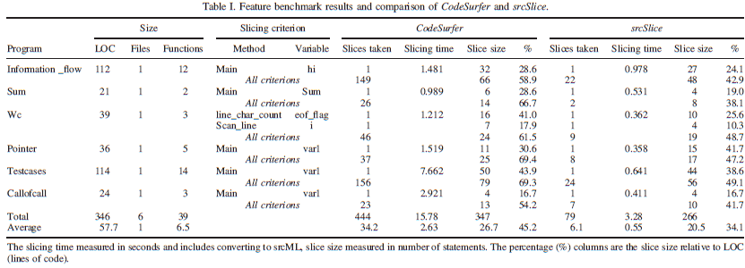
Feature Benchmark

Slide 27
Performance Benchmark
Statistics :
Size of program in LOC.
Size of program as both file and function.
Slice size relative to LOC.
Slices – number of forward slices for all possible criterions.
~1810 KLOC of C/C++ code from 20 open source projects.

Slide 28
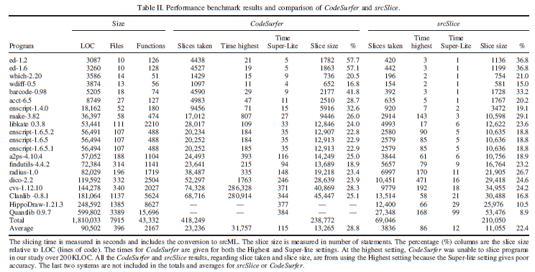
Performance Benchmark

Slide 29
Slice Intersection Comparison
Intersected slice – measure of quality.
Results ~= intersected slice, more accuracy.
Codesurfer – Higher Safety Margin.
srcSlice results consistently closer to intersection slices.

Slide 30
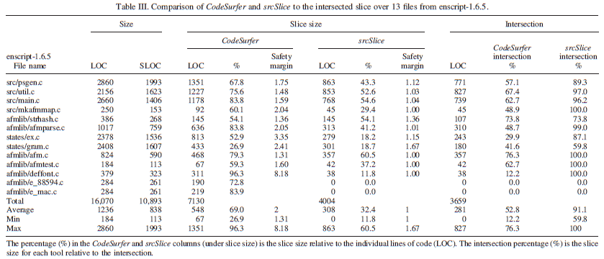
Slice Intersection Comparison

Slide 31
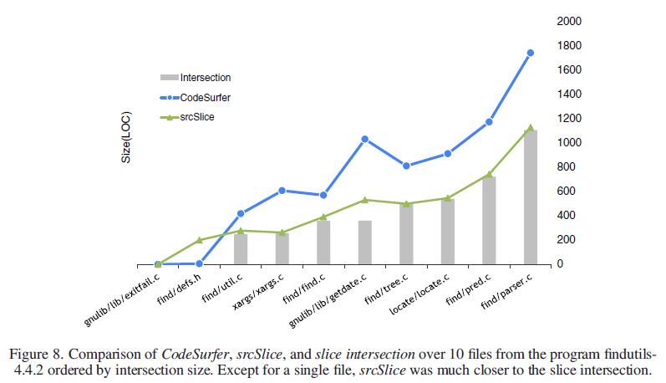
Slice Intersection Comparison

Slide 32
SrcSlice Scalability
srcSlice over Linux Kernel
Slicing criterion – (F, M, V).
748s. 1, 334, 504 slice profiles. ~4MLOC
974 versions of Linux kernels sliced.
Slice profile for each individual variable. O/P -> System dictionary

Slide 33
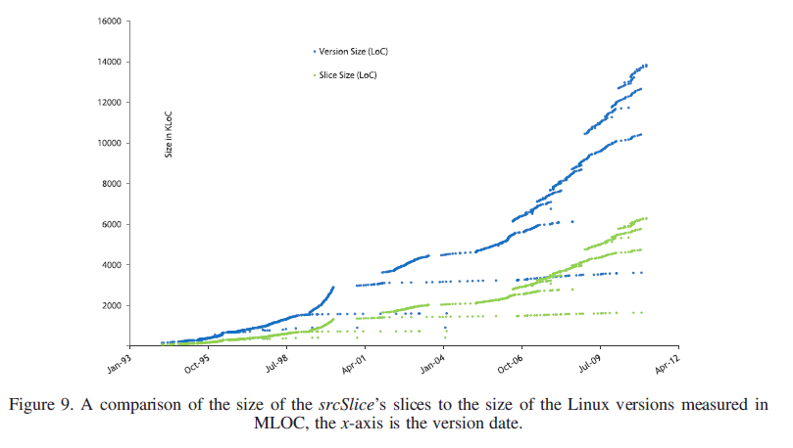
srcSlice Scalability

Slide 34
Related Work
Binkley et al – different implementations
Harman, Silvia et al – compare slicing techniques
Static vs Dynamic
Closure vs Executable
Inter procedural vs Intra procedural
Forward vs Backward
Conditioned, Amorphous, Union & Quasi Static.
Criterion – static, dynamic, hybrid.

Slide 35
Related Work (Contd)
Approach in paper – does not depend on SDG/PDG.
No Graph to traverse. No data flow to solve.
Slice calculated for every local and global variable.
Scalable in terms of time and program size.
Approach based on and extension of Gallagher’s decomposition Slice.
Adaption to forward static slicing.

Slide 36
Conclusion
Lightweight approach – applicable to both inter procedural and intra procedural slices.
Cannot be used as a complete alternative for CodeSurfer.
Used in cases where time and money is of the essence.
Efficient for large systems’ slices in short time.
Re engineering and refactoring.
srcSlice offered as part of srcML infrastructure.

Slide 37
Questions
Have you heard of program slicing earlier? If yes, have you used it in your projects?
Could backward slicing technique be used in place of forward slicing as per the paper’s approach?

Slide 38
References
http://www.cc.gatech.edu/~harrold/6340/cs6340_fall2009/Slides/BasicAnalysis6.pdf
http://www0.cs.ucl.ac.uk/staff/mharman/exe1.html
https://github.com/srcML/srcSlice
https://en.wikipedia.org/wiki/Program_slicing
Papers referenced at the glossary.

Slide 39
Thank you!

